Slide 1
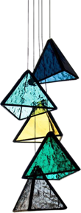
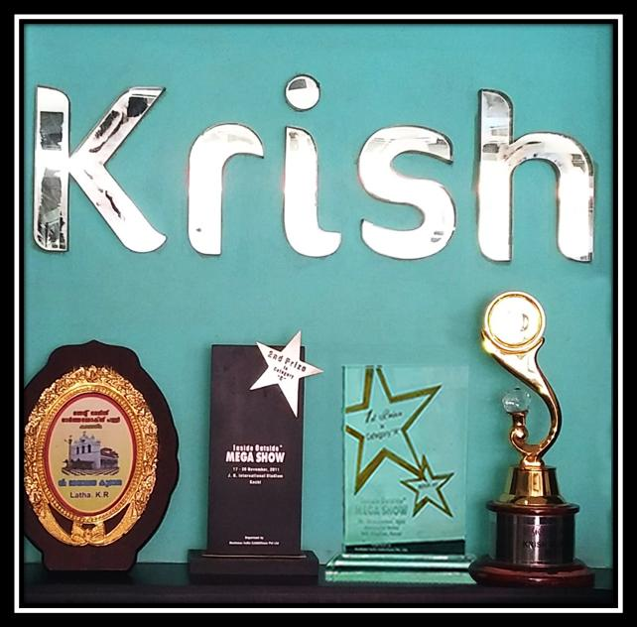

INSPIRATION IN GLASS
FOR YOUR INTERIORS
+91 92077 14173,+91-93888622843
www.krishglass.co.in
Mail: krishglassandglazing2014@gmail.com

Slide 2


ABOUT US
Established in 2008 in Kerala, Krish Glass and Glazing has been on a successful journey for over a decade. Managed by Mr. Ajithkumar and Mrs. Latha Ajithkumar, the company has flourished through persistent efforts in exploring various glasswork experiments using innovative designs and new technologies. This continuous pursuit of excellence has driven our growth day by day. We utilize technology not just in the mainstream but also to maintain global standards at every stage. Our services include comprehensive assistance with design solutions, technical support, and exceptional customer service from price quotation to product delivery.

Slide 3
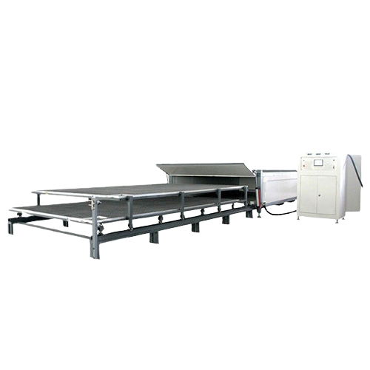
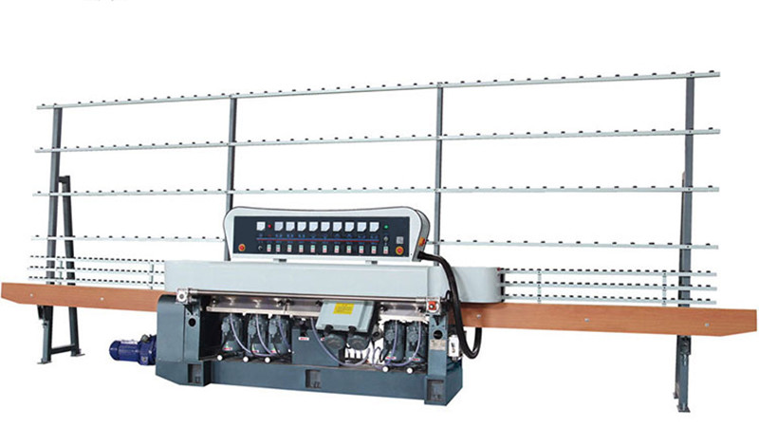
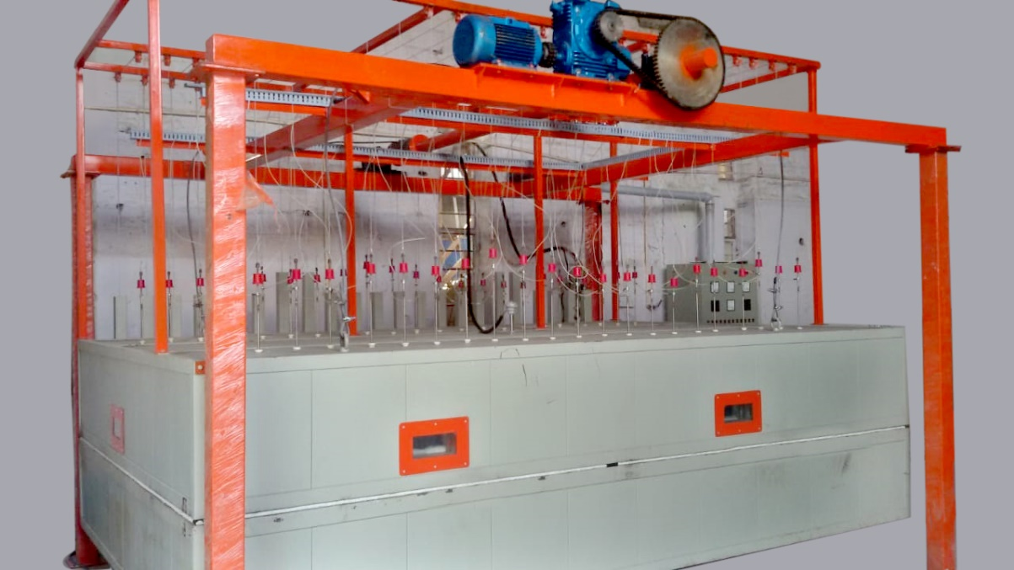
WHY CHOOSE US
Expertise and experience in glass work
Wide range of high-quality products
Customization to meet client Needs
Professional and reliable service
Competitive pricing
We are equipped with most modern technologies and machineries

Slide 4


Specialized Products
At Krish Glass and Glazing, we offer a wide array of specialized glass products and services, tailored to meet the unique needs of our clients. Our expertise includes:
Architectural Bend Glass
Polishing – Beveling/Taper/Straight
Fabric Lamination
Glass Fusion and Embossing
Glass Pillars/Glass Bricks
Stained Glass Work-Church/ Dome
Shower Partition
Toughened glass-Pergola /Shower Partition/Hand Rail
Acid Texture with Coloring
Glass Painting:
Plain Lacquered Glass
Glass Artwork and Crafts

Slide 5


Slide 6



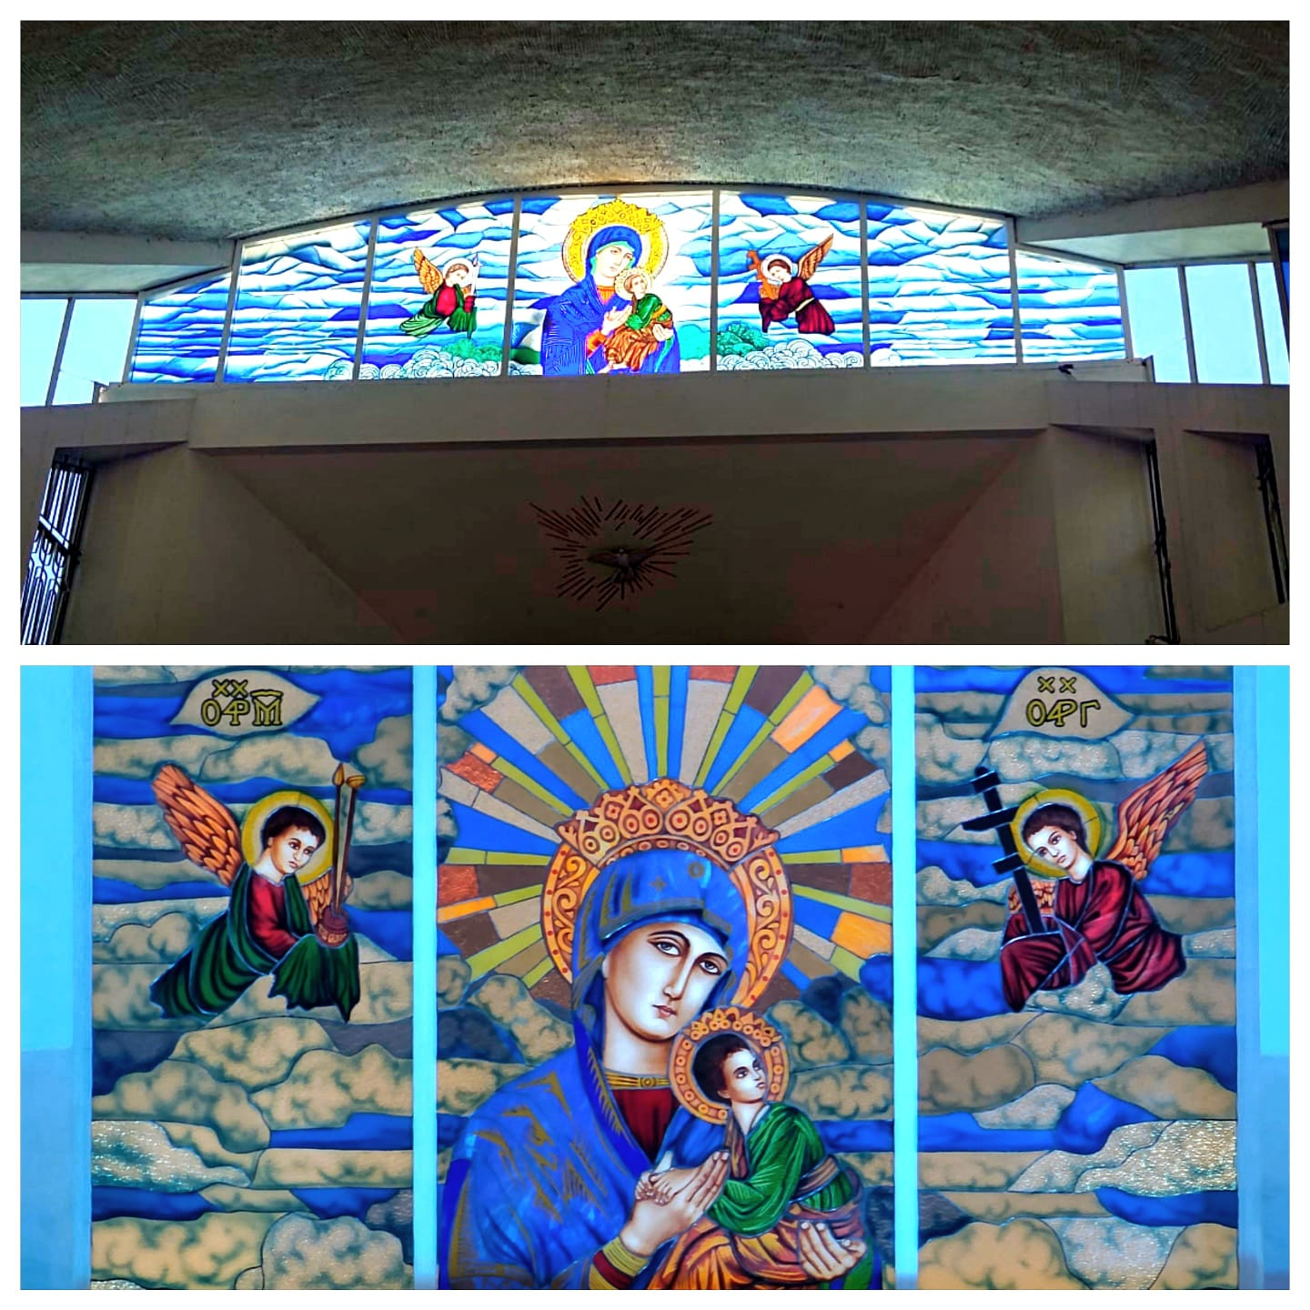
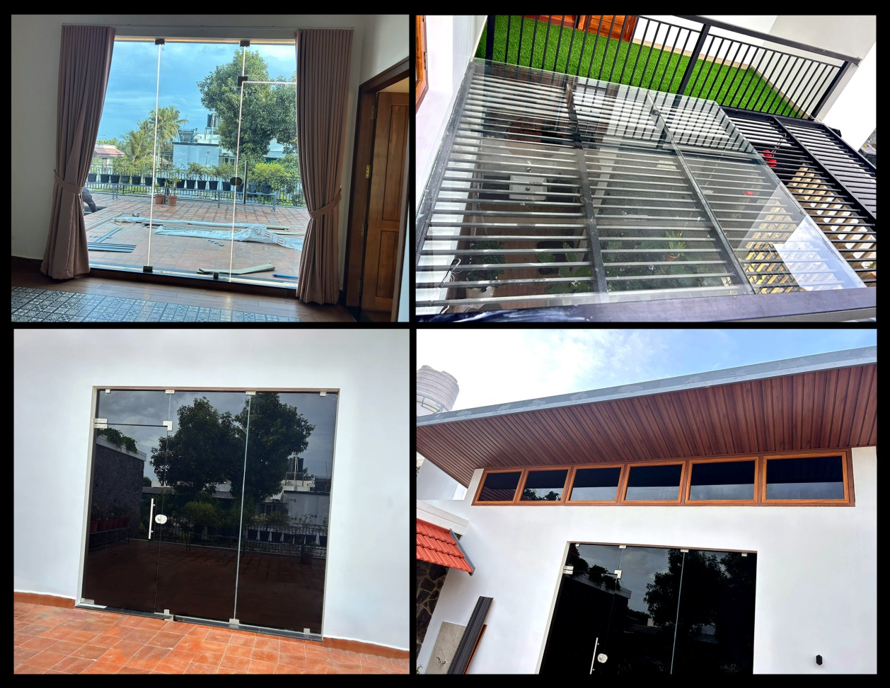
St. Francis Assisi Cathedral, Ernakulam
PROJECT SHOWCASE
BNI, Suresh Kumar Nair’s House at Perumbavoor

Slide 7
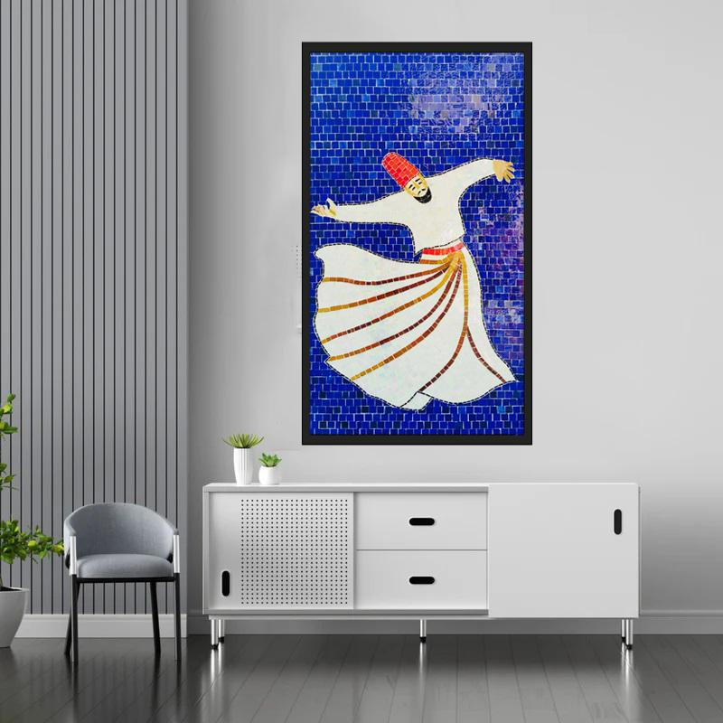
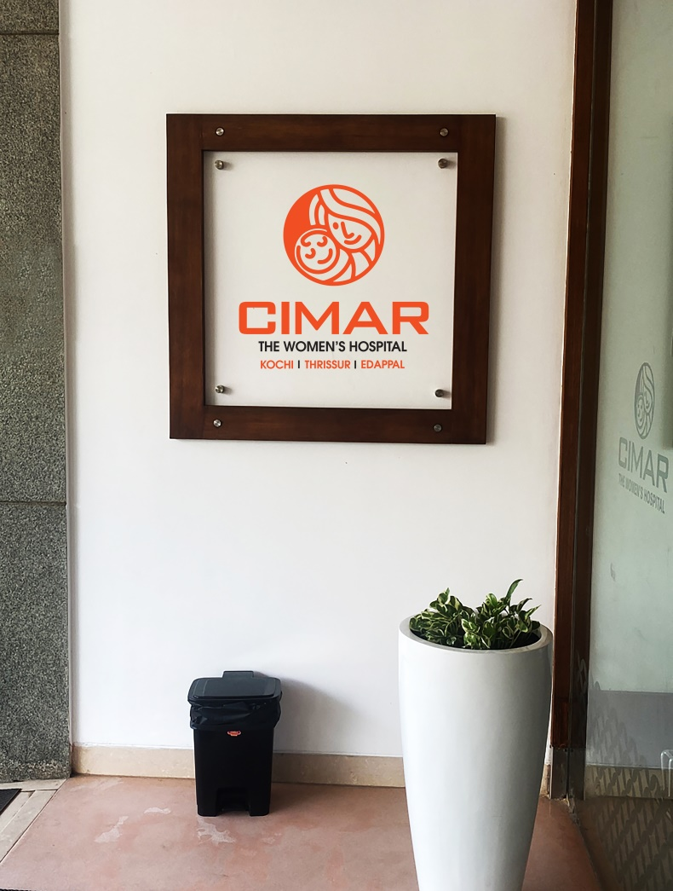
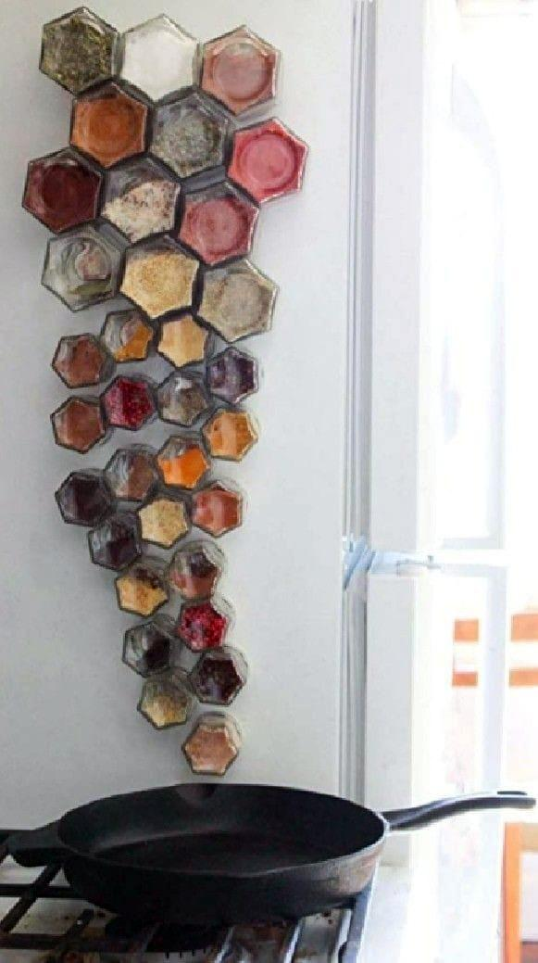
GLASS MOSAIC WORK
EMBOSSING
SPICE KITCHEN DOOR

Slide 8
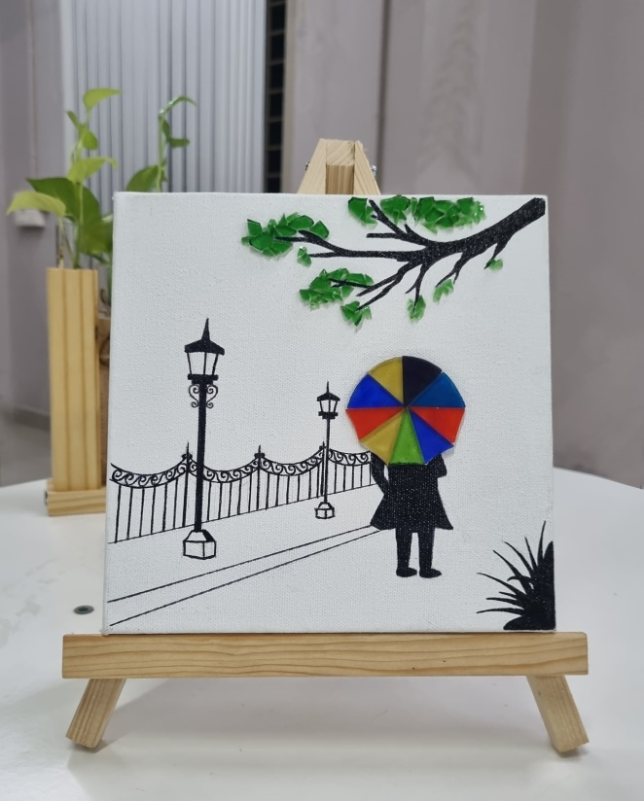
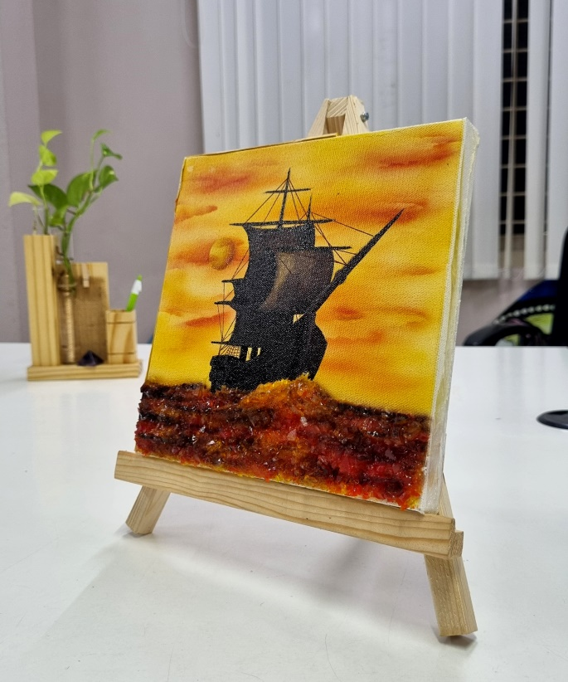
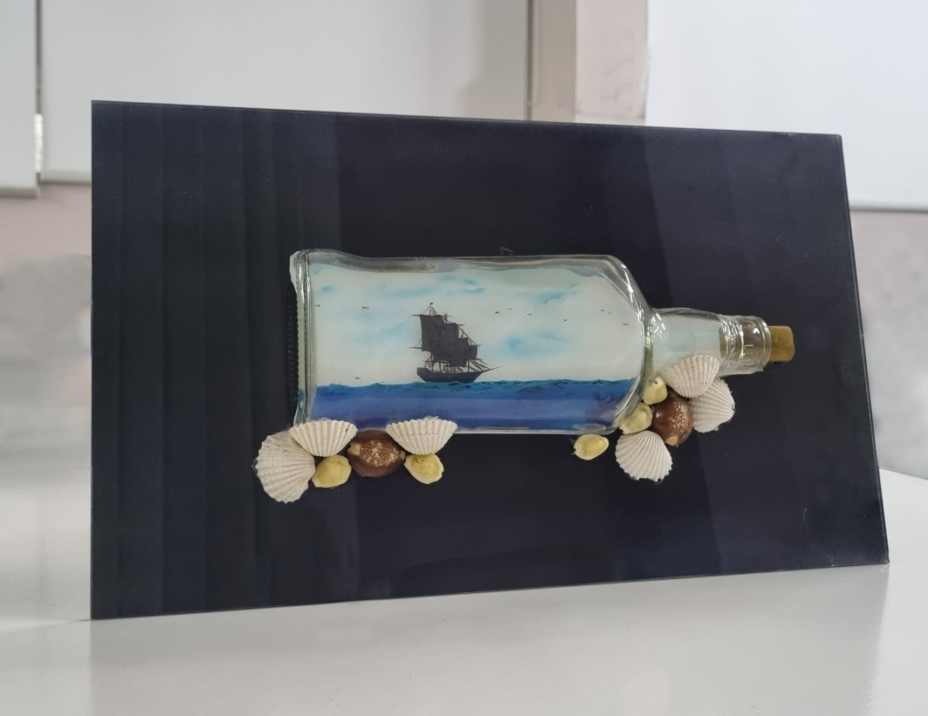
LAUNCHING…
Glass 'n' Canvas
Every piece of glasses tells a story in a artwork, capturing moments of inspiration, emotion, and beauty. We invite you to explore our gallery and discover the stories within our creations.

Slide 9



























OUR VALUED CLIENTS
At Krish Glass and Glazings, we take pride in serving a diverse and esteemed clientele. Some of our valued clients include:

Slide 10


PLEASE REFER ME
Architects
Interior Designers
Interior Contractors
Home Décor Shops
Institutions
The Hospitality Industry
Decision Makers for Villas, Flats, and Commercial Buildings
Glass Retailers

Slide 11





Krish Glass & Glazings
D.No: 1/101, Near Palakkal Temple Cheranelloore Ferry Road, Cochin -34, Kerala, India
PH: +91-93888622843 +91-9207714173
Mail:krishglassandglazing2014@gmail.com
Touch with us

